Slide 1
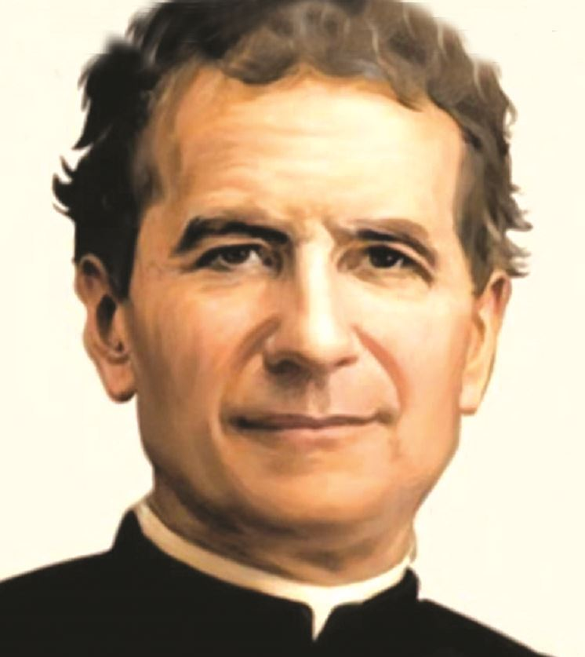
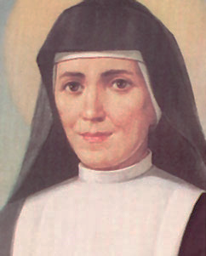
INSTITUTE OF THE DAUGHTERS OF MARY HELP OF CHRISTIANS
Founded by St. John Bosco
and by St. Mary Domenica Mazzarello
CIRCULAR
1015

Slide 2
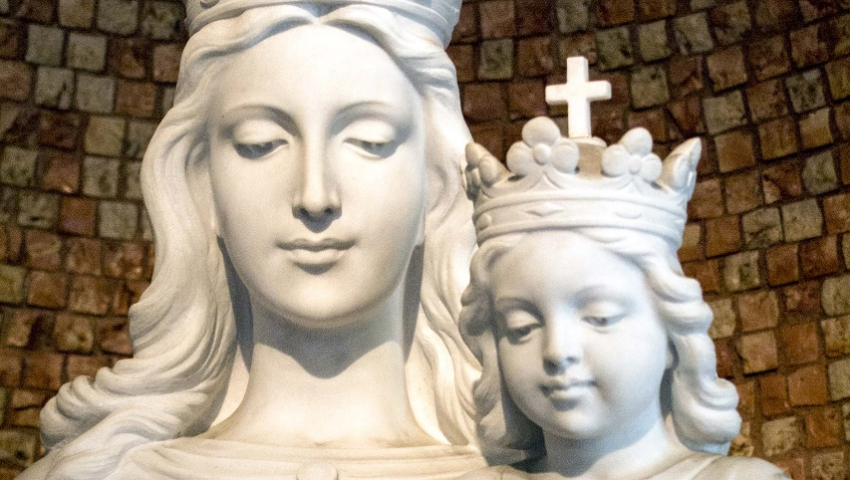
With Macy Communities that generates

Slide 3
Dearest Sisters,
I join you during the first plenary session of the new General Council in which, among the various commitments on the agenda, there is the important one of the elaboration of the 2021-2027 six-year programming. Once again, therefore, we ask your prayers so that the Lord may enlighten our work and that we can make choices that help the Institute to grow in line with the XXIV General Chapter.

Slide 4
The icon of Cana continues to accompany us on this post-chapter journey in which Mary's word to the servants resounds in our lives, "Do whatever he tells you" (Jn 2: 5). Let us entrust ourselves to her so that she may make us available to live the beatitude of believers (cf. C 44) in the commitment to be in contemporaneity a living 'presence’ that generates life.

Slide 5
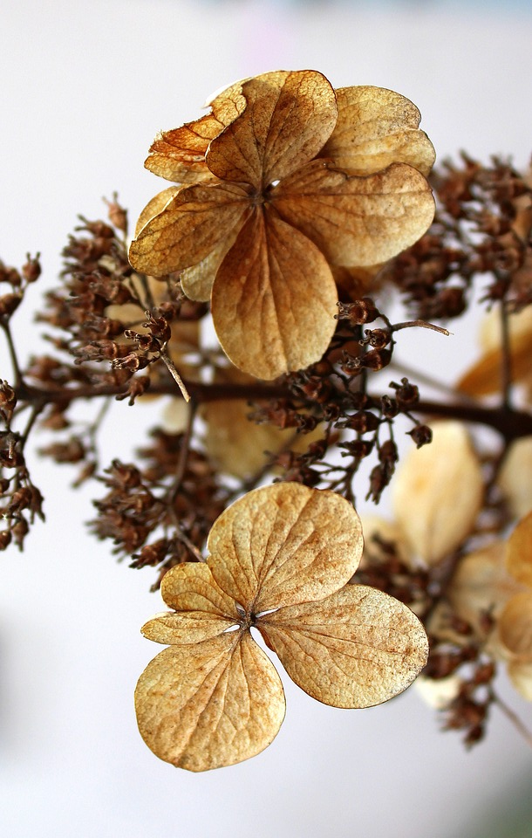
A generative charism
In the Acts of GC XXIV, the invitation to be generative communities emerges clearly, especially where suffering challenges our life, the mission entrusted to us, and the whole world. As educating communities, we are committed to recognizing God's calls and to considering the experience of the pandemic from a different perspective, as a new opportunity for the future of the Institute.

Slide 6
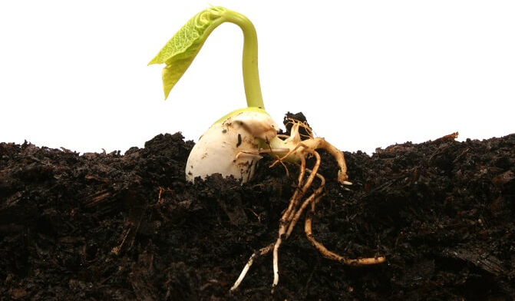
Generativity is a current and fruitful theme. In fact, we find ourselves living in a particular time in which there is a great need to be regenerated at various levels.

Slide 7
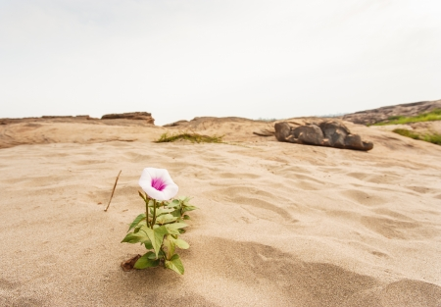
We are faced with a path that requires a profound renewal, a change, a journey of exodus. It is an appeal that opens up unprecedented educational and formative possibilities. We are called to inhabit history and to live in the present with wisdom and love, making the most of all the opportunities that are offered to us.

Slide 8
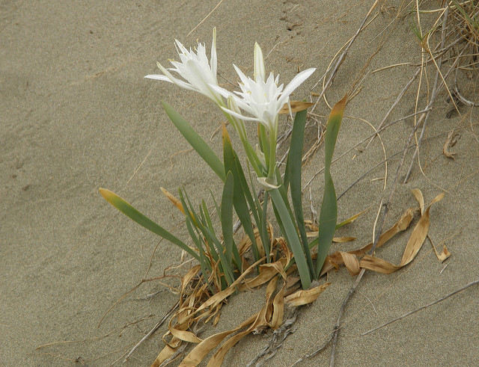
We also feel a strong need for generativity in the Institute. There is the need for a new vocational freshness; for positive interpersonal relationships that allow the atmosphere of a family to breathe; of unconditional trust. We need communities that are spaces where vocations for the Church, for our Institute, and for the Salesian Family mature. From here will come the fruitfulness and regeneration of our educational environments as well.

Slide 9
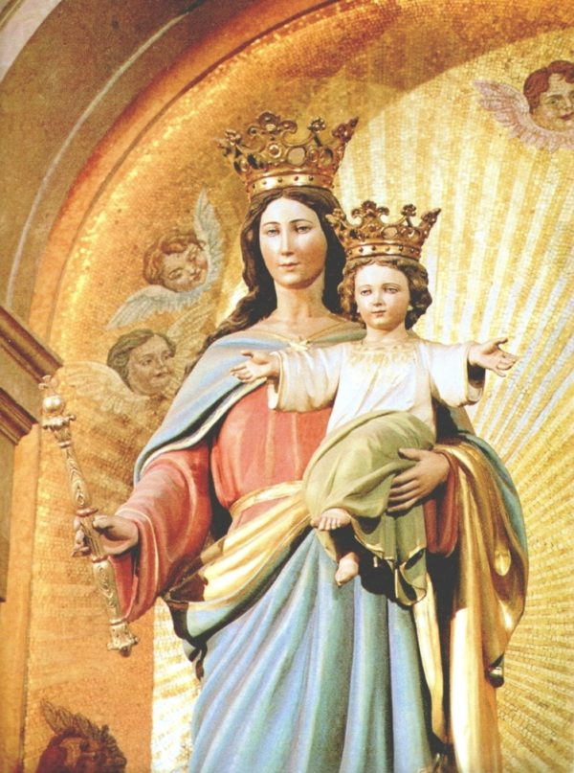
Don Bosco and Mother Mazzarello, from the beginning of their vocation and throughout their life, were guided by Mary in the art of caring. They involved young people in their project and, with them, they gave life to an original way of being missionary communities in the Church and in society.
Let us allow ourselves to be infected again by their pleasant and fascinating holiness in order to be generative communities, capable of awakening the original freshness of the vocational fruitfulness of the Institute. We must generate values and strengthen the resources of each one, even the hidden ones.

Slide 10
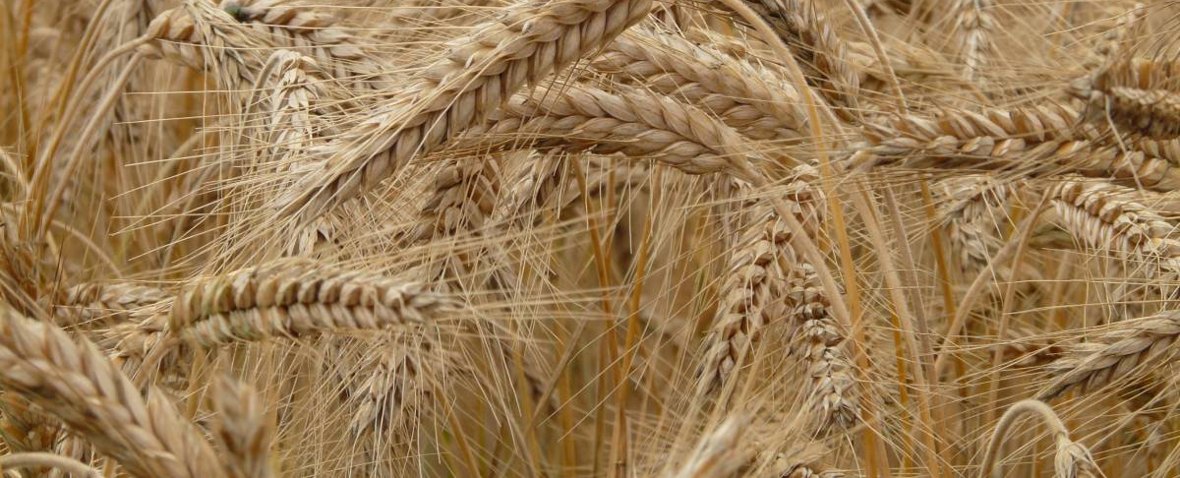
The community is the first place where we learn to accompany each other and to accompany young people to become aware of their vocation, to discover God's plan in their life, and to respond to it by giving the best of themselves. In the community, despite the limitations and frailties of each one, we learn to live communion and to sustain ourselves in fidelity (cf. C 49). Grateful to God for the gift of the call, we are aware of the responsibility of vocations in our Institute (cf. C 73).

Slide 11
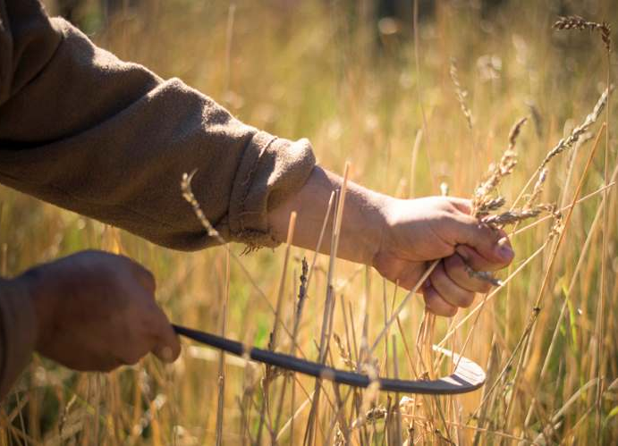
It is in the community that we discover God's will for us and, together, we welcome the signs of it present in our sisters and brothers, in social and ecclesial situations, and in daily reality (cf. C 30).

Slide 12
Pope Francis, at a UISG meeting a few years ago, asked himself, "How come the womb of consecrated life has become sterile?"
In today's context, consecrated life is called to an evangelical-charismatic rebirth. For this reason, the first and most decisive commitment is to awaken the passion for Jesus and the educational passion, starting from one's own existential experience, placing ourselves in front of current challenges with a gaze of hope and trust.

Slide 13
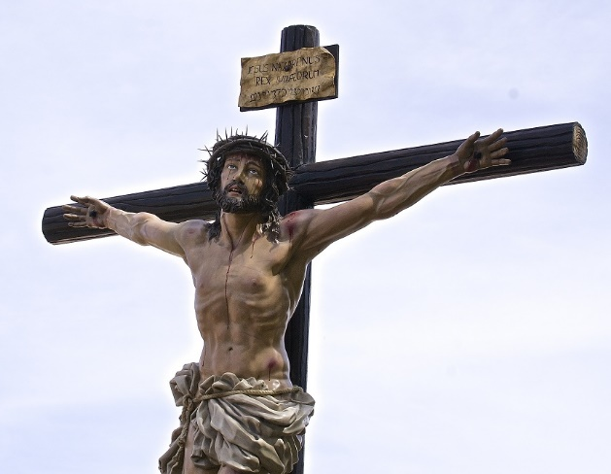
To be a significant presence
To be generative like Mary and with her help, it seems important to me that each of us, and also together as a community, verify if God is truly at the center of the heart, of the choices, of our whole life and mission. Questioned by the serious challenges of today and the new educational needs of young people, we feel the need to fix our gaze on Jesus with new intensity, to cultivate interiority to overcome the risk of spiritual worldliness and activism. And when God is at the center of life, of communities, of mission, our presence becomes capable of radiating light and joy.

Slide 14
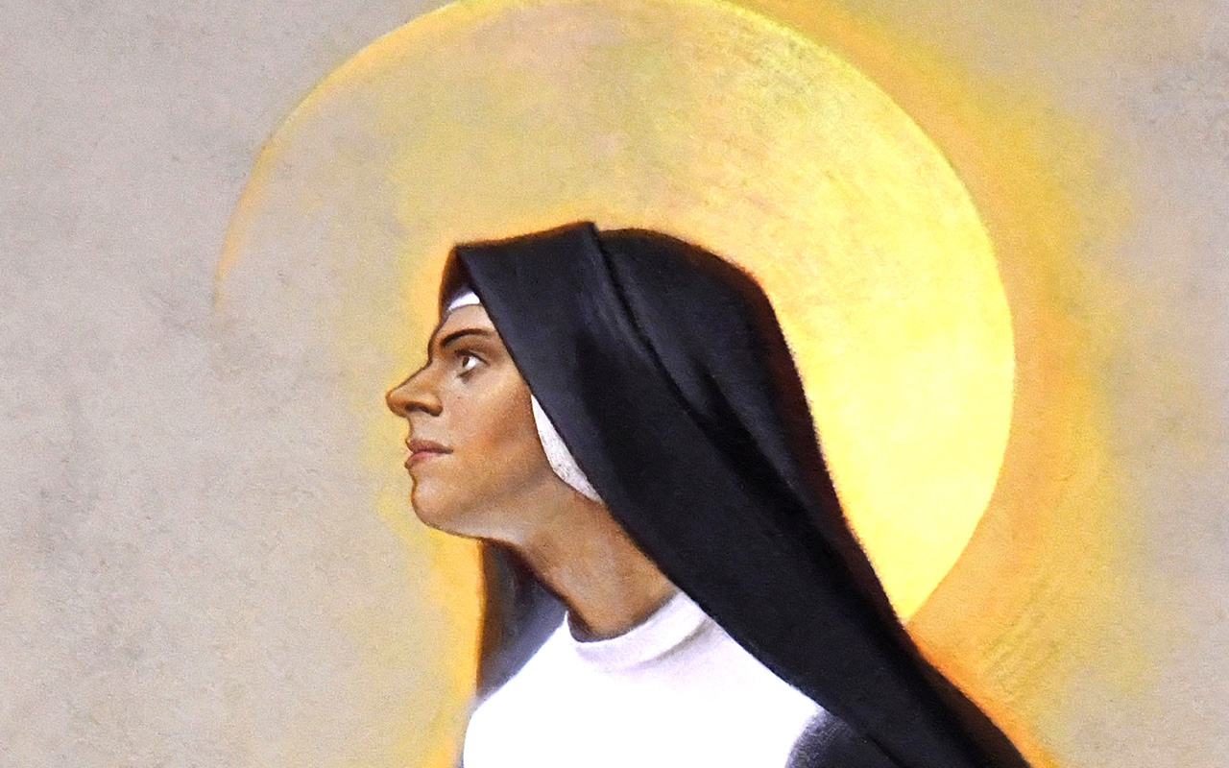
Mother Mazzarello was a woman who, only with her 'being there', revealed God because she was inhabited by Him and lived constantly in Him. It is here that we can find the secret of the educational fruitfulness of the mission lived by her and by the first communities of the FMA.

Slide 15
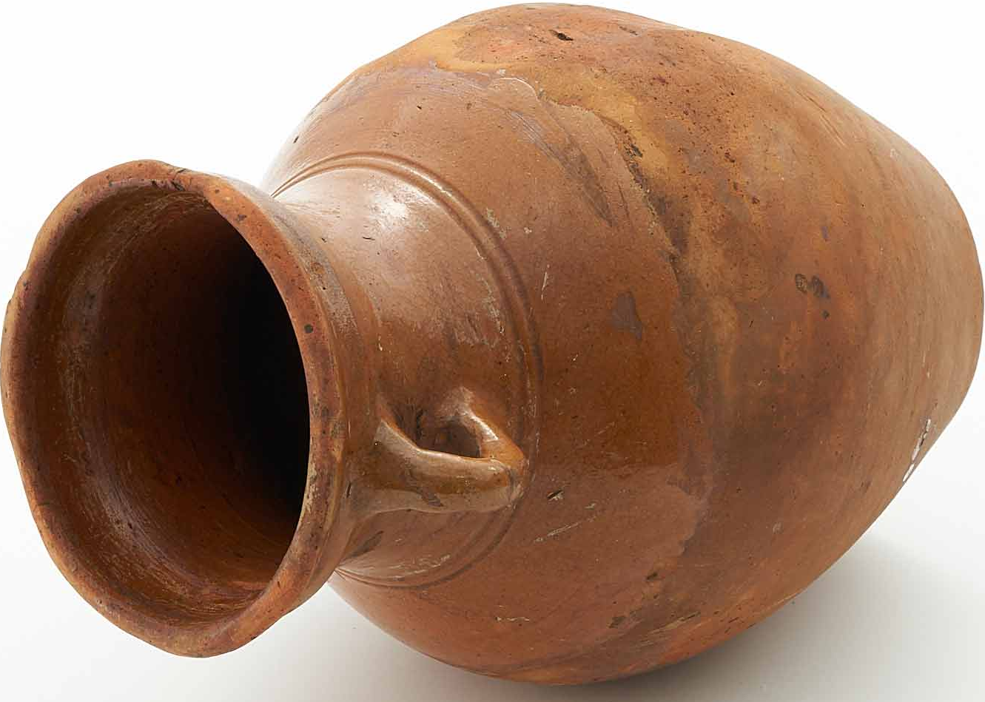
When God is not at the center of life, our words and our work risk being empty. The charismatic passion, which makes the presence among young people meaningful, finds its roots in the mysticism of the "da mihi animas" and in the asceticism of the "cetera tolle". We cannot live one without the other.

Slide 16
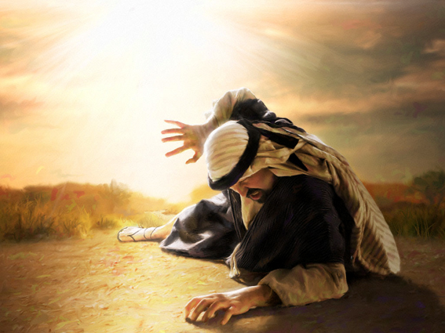
If there is no dazzling encounter with Jesus, neither is there the fruitfulness of the mission.

Slide 17
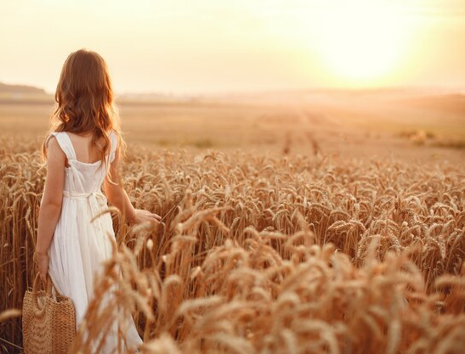
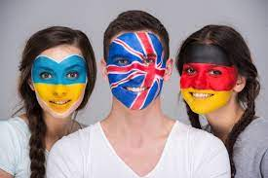
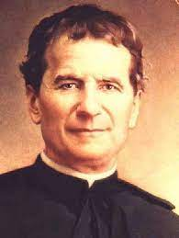
Don Bosco outlines for us a path of evangelical radicality, an essential condition for being able to be ‘vocational’ communities as GC XXIV reminds us: "As members of the educating community we are all invited to assume the vocational culture, which can allow every young person to discover and live their own life project.

Slide 18
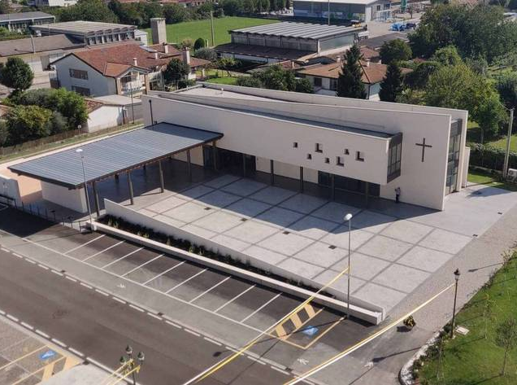
For this reason, it is indispensable to build educational environments where Salesian spirituality is lived daily, and the sacramental life, listening to the Word, prayer, discernment, personal and community accompaniment, the joy of sharing and planning together is valued" (Acts GC XXIV, n.12).
oratorio di Caselle di Altivole TREVISO

Slide 19
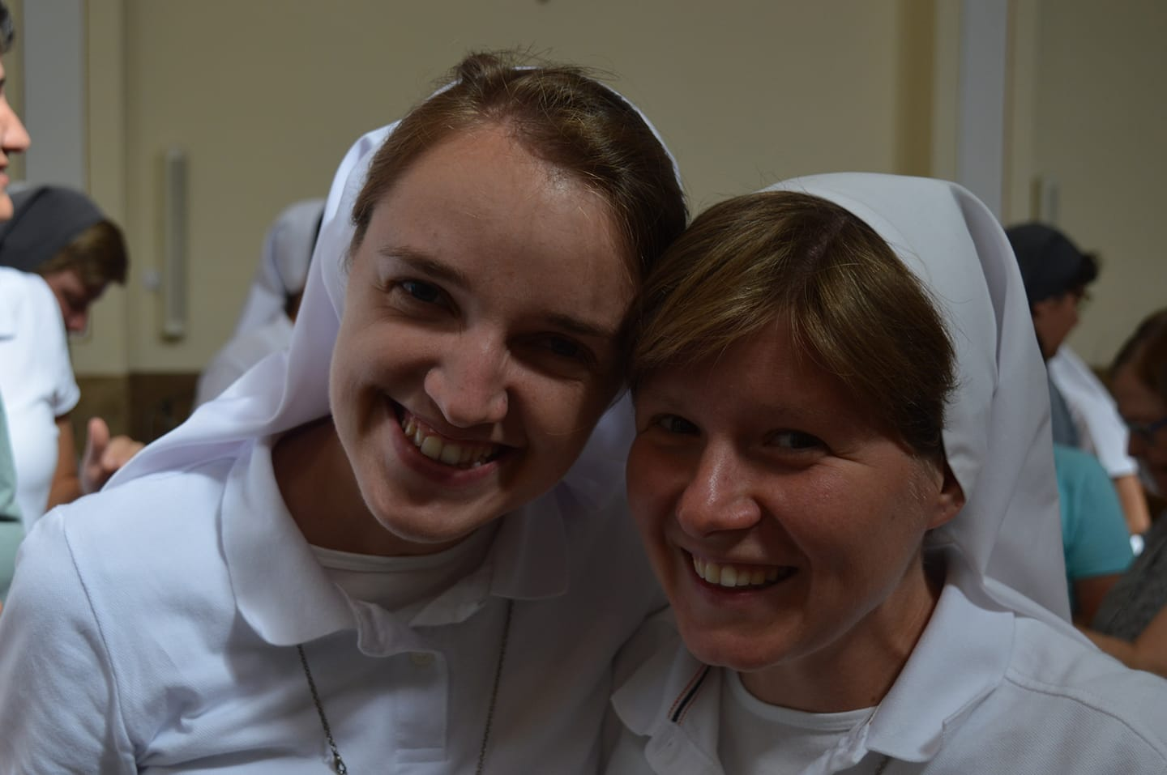
This responsibility, shared with the educating community, is for us an expression of fidelity to the prophetic dynamism of the charism which translates into the vital assumption of the vocational culture shared with the young, with the laity with whom we experience daily the transforming beauty and strength of the call of God.

Slide 20
This responsible fidelity, which urges us to accompany young people, will be able to make our communities truly generative in the Church and in the various contexts where God asks us to work.

Slide 21
If we start from the conviction that the Holy Spirit continues to arouse vocations to the priesthood and religious life in the Church, then we can "cast the nets again" in the name of the Lord, with full confidence. We can, and must, have the courage to tell every young woman to ask herself about the possibility of following this path (cf. Christus vivit, n. 274).

Slide 22
Before saying ending, I remind you that this year the 150th anniversary of foundation, as the Vicar General, Sr. María del Rosario García Ribas has already communicated to you, the Feast of World Gratitude will also have a special meaning because it will take place in our 'holy land': Turin, Mornese, Nizza. Each of these places reminds us of the presence of Mary in the history of the origins and in the present day of our Institute.

Slide 23
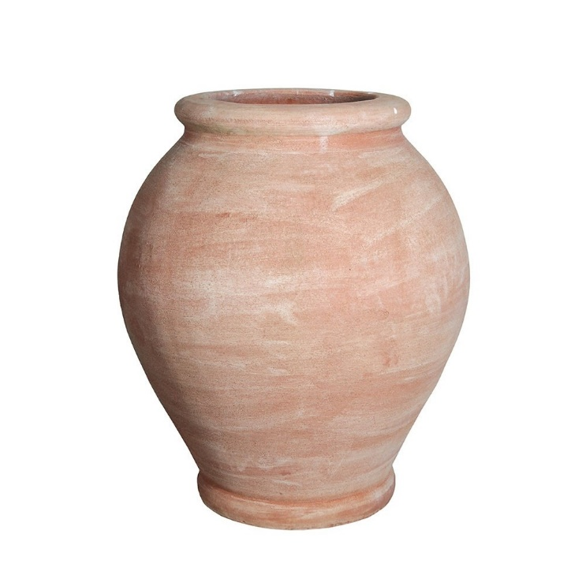
For this reason, the Piedmont "Mary Help of Christians" Province, which is organizing the event, will propose to us in harmony with GC XXIV, the presence of Mary as the theme and guiding thread of the journey of preparation and realization of the feast.

Slide 24
I pray that you may live Lent as a time of re-launching the journey of holiness, ready to "go forward with a big and generous heart" (L 47,12).
May Mary Help of Christians bless you and sustain you.
An affectionate greeting from me and from the Sisters of the Council.
Rome, 24 February 2022
Affectionately, Mother
ma Madre

Slide 25
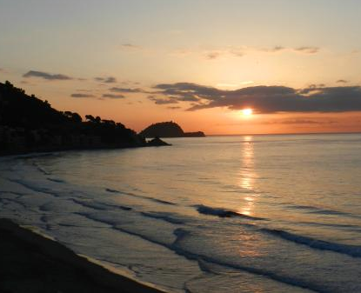
Sr. Alba Vernazza fMA
albaver@libero.it

